Slide 1

Info 581- Process Mining to Discover Inefficiencies in Tasks.
Jason Van Wyck
Notes:
With a dataset about prepaid travel costs and the processes involved, I dive into what are the bottlenecks that exists and how to streamline the processes using Celonis.

Slide 2
Objective(s)
Analyze the provided datasets through Celonis EMS to reveal opportunities for improvement in organizational performance
Delve deeper into individual steps and activities that occur in the business process
Discover important relationships between steps and activities and the different details such as the duration and position in the process
Provide recommendations based on our findings that when implemented will lower organizational costs
Notes:
In this project, the main focus is to come up with the recommendations of improvements for processes that contain inefficiencies.
For the prepaid travel costs, we have a dataset of the different tasks and the time and processes involved.
Using process mining with Celonis, we dive into the processes to uncover the inefficiencies, when and where they occur and how long they take and the ways of improving them.
The output is the recommendations that can be implemented by the firms and increase inefficiencies.

Slide 3
Problem Solving Steps (Data & Analysis)
Defining the Core Issue: The throughput time for the prepaid travel cost activities exceeds the optimal average of 24 days by 13 days.
With a hit rate of 52%
Using Celonis models, we were able to observe the distribution of the time each case and identify the activities that have negatively impacted the throughput time
Analysis provided evidence that the hit rate may be increased to 95% with attention to certain activities
Production orders data also revealed activities that negatively impact the process

Slide 4
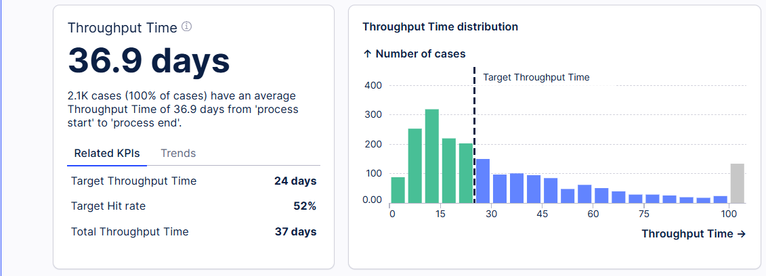
Throughput Time
Throughput Time:
approximately 37 days
target throughput is 24 days
Hit rate of 52%
Notes:
Throughput Time:
It takes approximately 37 days which is longer than what should be the average of 24 days.
This is an achievement of 52%, which means we are wasting half the time of the tasks

Slide 5
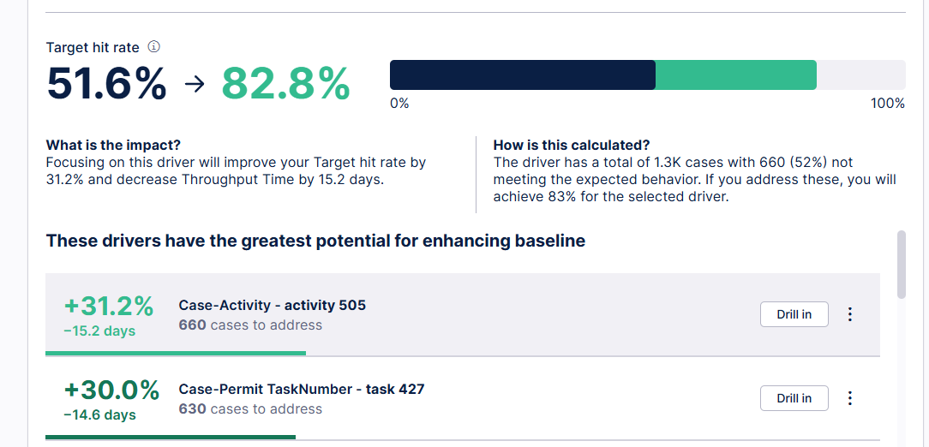
Most Impactive activity
With correction to Activity 505, improvements may be seen:
Appears in 660 cases
Raises the throughput by 15.2 days
Target hit rate may rise to 82.8%
Notes:
With a hit rate of 52%, it means the 48% of the time in the tasks is wasted. Using process mining, I identify the areas which have the most impact. Just by focusing on the first activity-activity 505, we increase the hit rate to ~83%, increasing the time by 15 days.

Slide 6
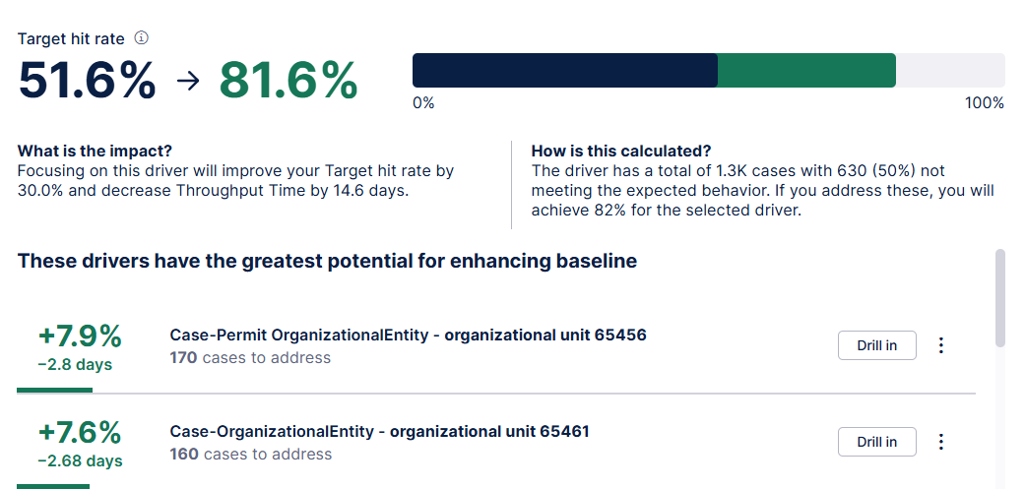
Second Activity
Activity 427 also shows potential to improve the process with correction:
Appears in 170 cases
Target hit rate may rise to 81.6%
Corrections should be focused in units 65456 and 65461
Notes:
Using process mining, I identify the areas which have the most impact. Just by focusing on the second task-task 427, I increase the hit rate to ~81.6%, increasing the time by 14 days. I drill in and see that drivers of this increase are in organization unit 65456 and unit 65461

Slide 7
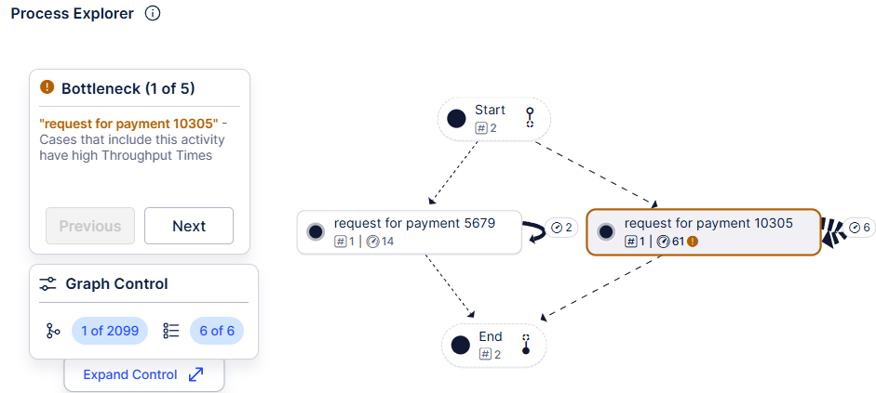
Dashboard 4- bottlenecks, task 1
Process mining shows the tasks that create the most bottlenecks. Cases with activity 10305 have an average of 6 more days while those without have median of 1 day. This time wasting tasks requires changing.

Slide 8
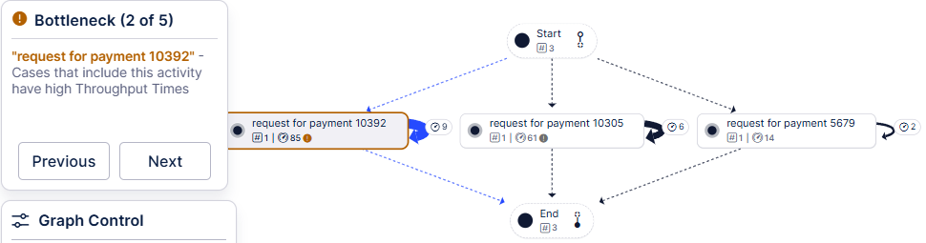
Dashboard 4- bottlenecks, task 2
Process mining shows the tasks that create the most bottlenecks. Cases with activity 10392- request for payment- have an average of 6 more days while those without. The total throughput time is 85 days. What a time waster!

Slide 9
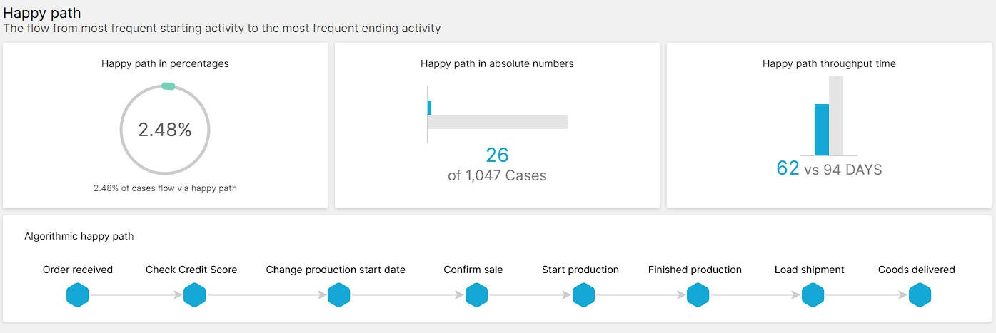
Optimal Route
optimal route or the happy path contains 8 activities
Throughput time is 62 days
26 out of 1,047 cases

Slide 10
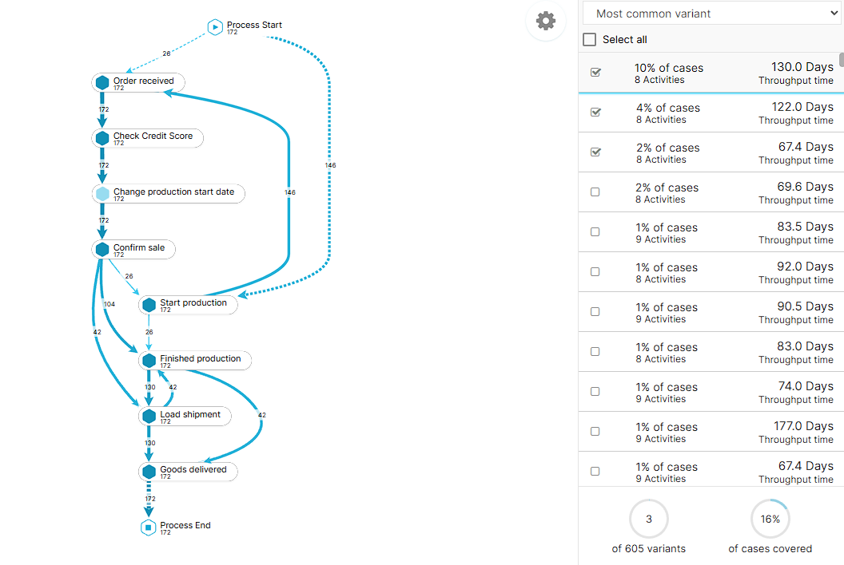
Process Explorer
Optimal route is third most taken
16% of all cases
Deviations increase by almost double

Slide 11
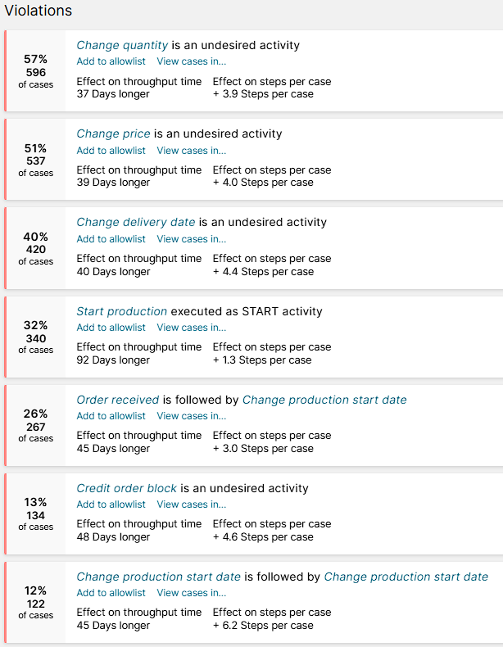
Violations
Key process violations significantly delay throughput times (up to 92 days)
Common issues include changes to order details (quantity, price, delivery date), production scheduling errors, and credit-related blocks
affect a large proportion of cases
Notes:
highlighting areas for process improvement to reduce delays and streamline operations

Slide 12
Recommendations
The first major step is to reduce the time inefficiency- reducing the time from 37 days to less than 24 days. That also means increasing the hit rate from 52% to more than 95%.
To improve the throughput times, we changes the cases with the following activities: activity 10305, activity 10392, activity 1053, activity 10847, activity 11058- all request for payments.
To include activities that have a highest potential to improve the baseline. Such activities as activity 505 and task 427 among others.
Focus on fixing common violations and promoting the optimal route

